Slide 1
Project Management/Construction Management Consultant Services for Design-Bid-Build Projects for Coastal Resiliency
November 28, 2018
Eric Macfarlane, P.E
Deputy Commissioner

Slide 2
What does the Department of
Design + Construction do?

Slide 3
Infrastructure
Portfolio
Estimated
Construction Value
650
$9.5
Projects
Billion

Slide 4
PM /CM / REI Pre-Solicitation Conference
- Coastal Resiliency Project Management and Construction Management
- Citywide Pedestrian ADA Compliance Program
- Green Infrastructure Monitor (GIM)

Slide 5
What is Coastal Resiliency?
Coastal Resiliency (CR) Program is an initiative undertaken by the City’s primary capital construction project manager, Department of Design and Construction (DDC), to confront the risks of extreme weather and climate change that have been more recognized in the last few years by building a more resilient New York.
What is Coastal Resiliency?

Slide 6
What is Coastal Resiliency?
It is DDC’s vision and mission to combat the effects of climate change by strengthening the City’s coastal defenses, by upgrading and fortifying buildings, by protecting the City’s Infrastructure and services and by making our neighbor's safer and more vibrant.
What is Coastal Resiliency?

Slide 7
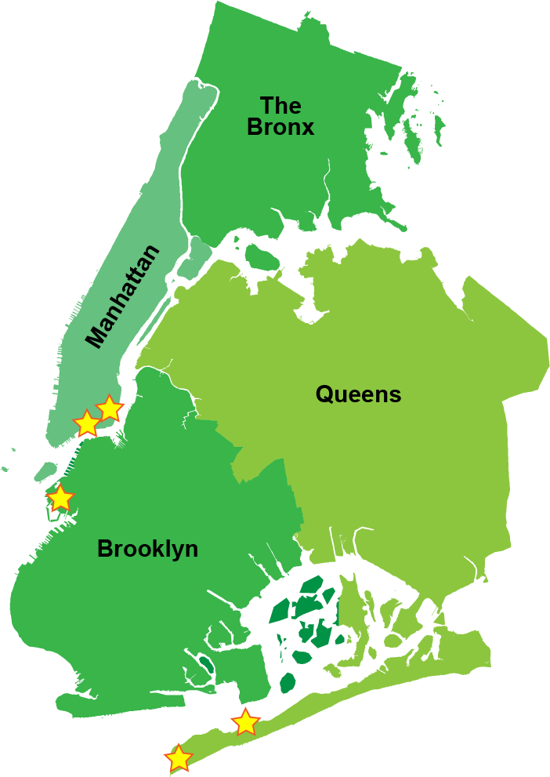
What is Coastal Resiliency?
Proposed Locations:
Manhattan:
East Side Coastal Resiliency (ESCR)
E 25th Street to Montgomery Street
Lower Manhattan:
Two Bridges Coastal Resiliency (TBCR)
Montgomery Street to Brooklyn Bridge
Brooklyn:
Red Hook Integrated Flood Protection System (RHIFPS)
Beard Street & Atlantic Basin
Queens:
Breezy Point Coastal Resiliency (BPCR)
Western end of the Rockaway Peninsula
What is Coastal Resiliency?

Slide 8
Project Management/Construction Management
Consultant Solicitation
DDC intends to issue a request for proposals for project management/construction management consultant for the NYC Coastal Resiliency Program.
DDC is looking for a PARTNER to help us build and manage all design-bid-build projects for the Coastal Resiliency Program.
Consultant Solicitation

Slide 9
What DDC is Looking For in a Partner
Leadership
Design-Bid-Build Expertise
Dynamic Thinker
Innovative Problem Solver
Enterprising Professional
Professional Advisor
What DDC is looking for in a Partner

Slide 10
Why do we need a PM/CM?
Large scale Firm to manage all coastal resiliency projects is a first for DDC and the City
Confidence in the success of the project or program
Effective use of available funds
Enhanced control of the scope of work
Why do we need a PM/CM?

Slide 11
Anticipated PM/CM Scope
Manage , Supervise, Coordinate and Cooperate with construction contractors and any consultants.
Provide Construction Management services and be tasked with ensuring overall program compliance with agencies.
Procurement Management and Support.
Development of construction site access logistics
Project and Construction Administration.
Adhering to Scope Baseline, Schedule Baseline and Cost Baseline.
Why do we need a PM/CM?

Slide 12
PM /CM / REI Open House
- Coastal Resiliency Project Management and Construction Management
- Citywide Pedestrian ADA Compliance Program
- Green Infrastructure Monitor (GIM)

Slide 13
Program Scope
A 29-year, $5 billion program to make an estimated 160,000 corners of NYC ADA compliant. Current plan is for DDC to contract out 71,433 corners and DOT to use in-house Union labor force to do the balance.
FY 2019 in procurement: Upgrade Simple - 7052 corners estimated construction cost $86 million.
FY 2021 in design: Install Complex - 319 corners estimated construction cost $32 million.
Proposal to use Simple Upgrades as opportunity for participation of small contractors’ citywide.
Upgrade simple = 53,392 Corners valued at about $844 million - 10 years program for the upgrading an estimated 106,784 Pedestrian Ramps (assuming 2 Ramps per Corner)
Program Scope

Slide 14
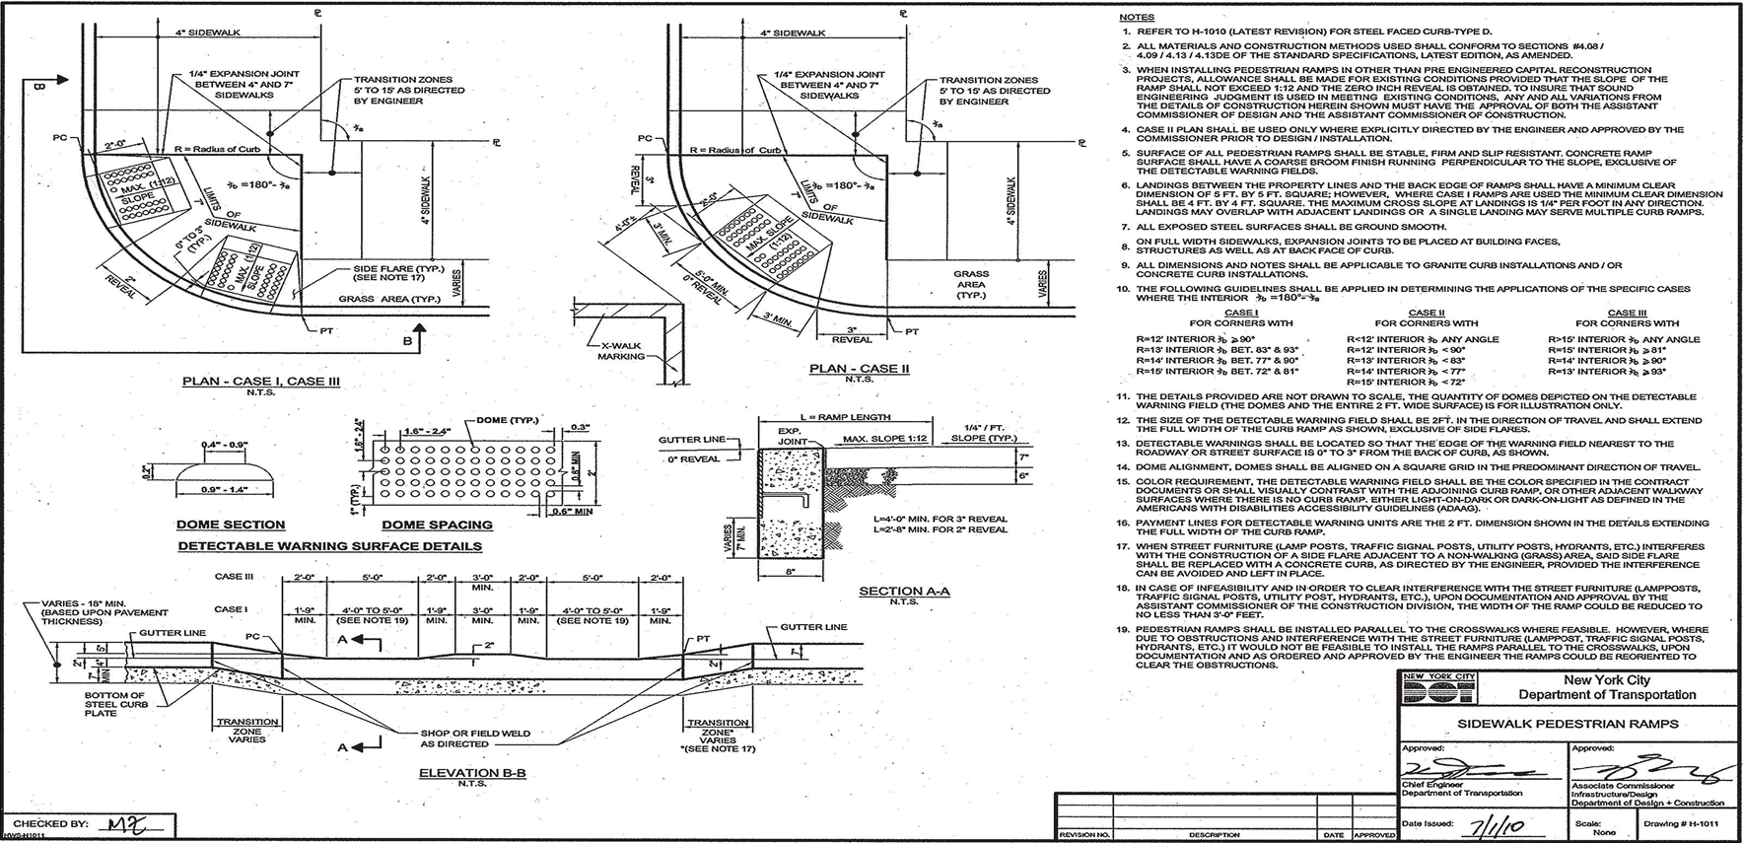
Standard Drawing - NYCDOT

Slide 15
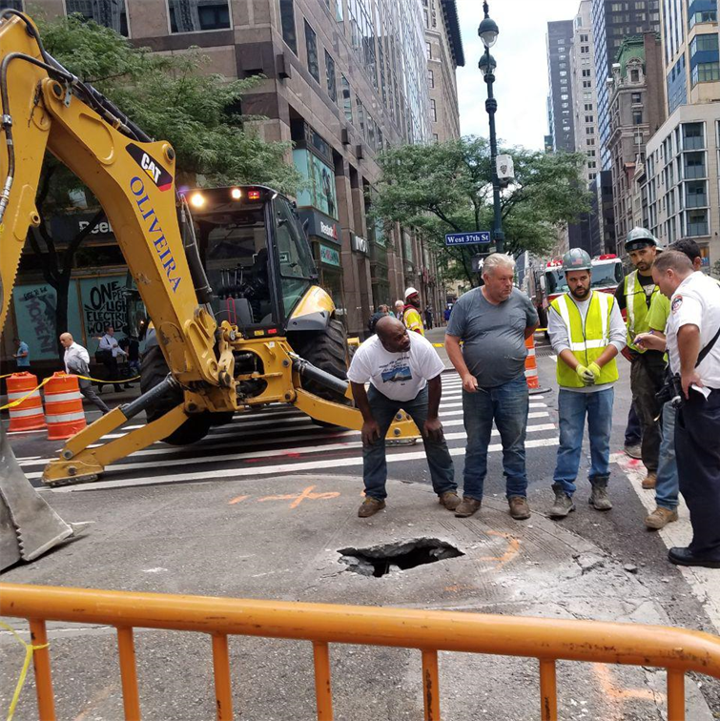
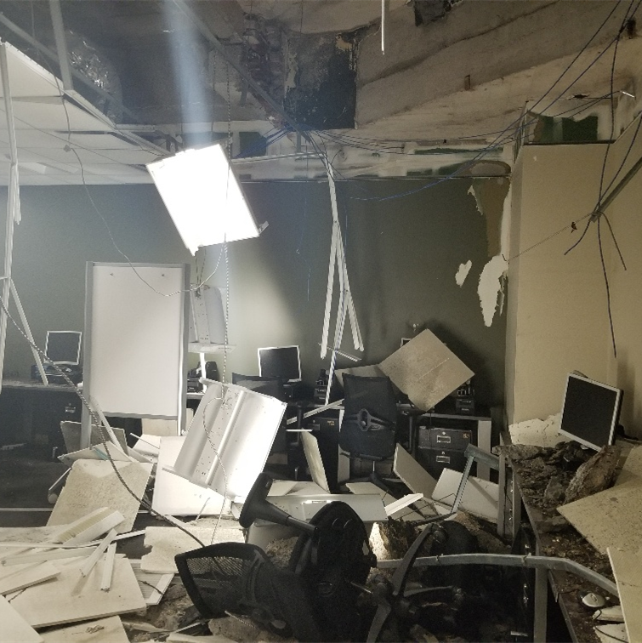
Complex Ramp

Slide 16
Remaining Corners To Be Done Number Of Contracts And Duration Based On Past Performance
CORNER TYPE | Number of Corners | Required Number of Contracts | Program Duration DES + CONSTR - YEARS | Corners per Contract
INSTALL-SIMPLE/STD | 424 | 1 | 2 | 424
INSTALL-NYCTA COMPLEX | 133 | 3 | 5 | 44
INSTALL-COMPLEX | 1528 | 32 | 5 | 48
INSTALL-LANDMARK COMPLEX | 161 | 3 | 5 | 54
UPGRADE SIMPLE | 53392 | 53 | 10 | 1007
UPGRADE- COMPLEX | 15795 | 310 | 25 | 51
 | 71433 | 402
Remaining Corners to be Done

Slide 17
PM /CM / REI Open House
- Coastal Resiliency Project Management and Construction Management
- Citywide Pedestrian ADA Compliance Program
- Green Infrastructure Monitor (GIM)

Slide 18
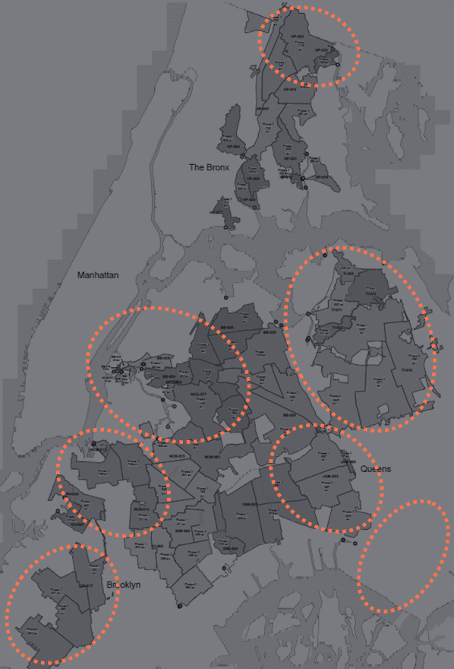
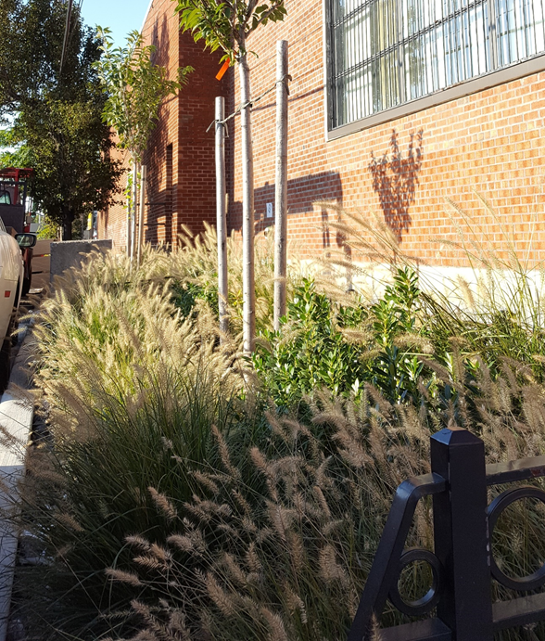
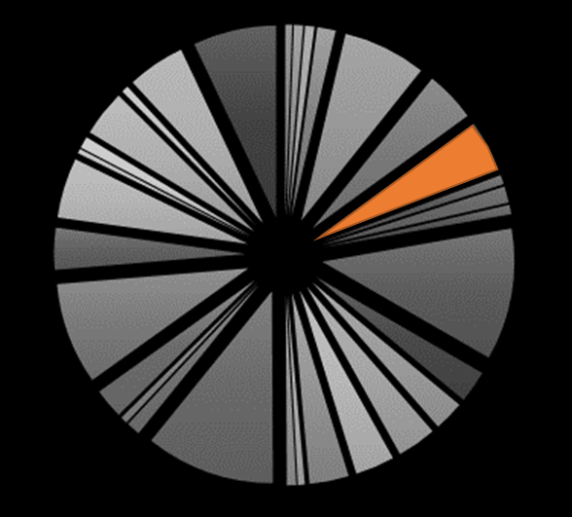
Green Infrastructure Monitor (GIM) - City Wide
FY 2019 Construction Contracts with a Projected Value of $130M
FY 2020 – FY 2022 Construction Contracts with a Projected Value of $260M
Green Infrastructure Monitor (GIM)

Slide 19
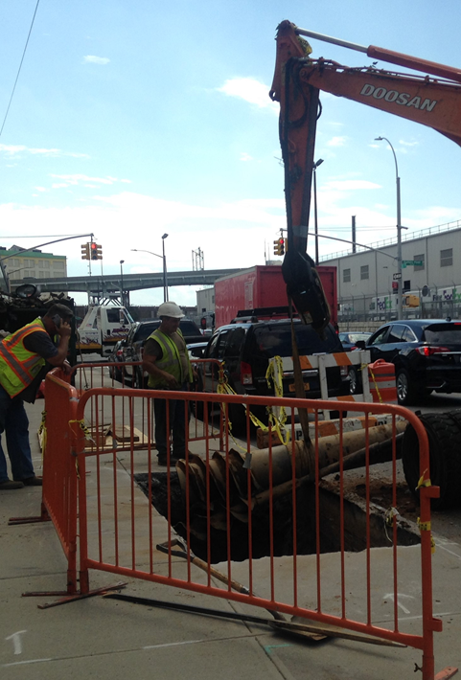
Role of the Resident Engineer & Inspector
- Detail oriented supervision and inspections
- Emphasis on adherence to Contract Specifications & Drawings
- Strict enforcement of the project schedule as per Article 6.3.4
- Utilize tools to maintain high quality work from Contractor
- Many notable changes GI Contracts with new method of incremental payment for maintenance and plant establishment
- Utilize CM Checklists provided by DEP
- Random DEP Construction Monitor Inspections
Role of the Resident Engineer & Inspector

Slide 20
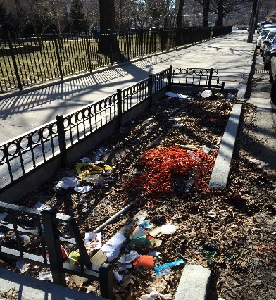
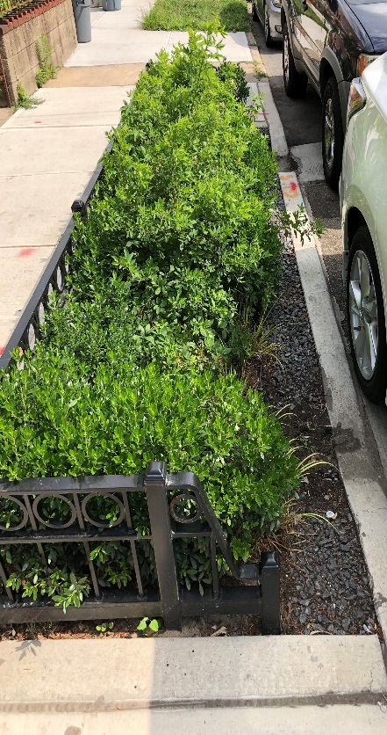
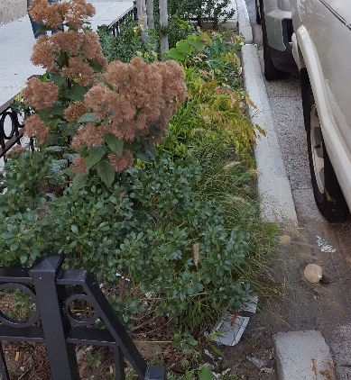

Maintenance of Green Infrastructure (GI)
- Regular maintenance is crucial for the GI Practices to perform and prolong their lifespan
- Sediment Control before, during and after construction
- Litter Removal is essential for the success of the GI Program
- Introduction of Green Infrastructure Monitor (GIM) to REI services for GI Construction Contracts
Maintenance of Green Infrastructure (GI)

Slide 21
Green Infrastructure Monitor (GIM)
Scope:
- Services required during the 12-month guarantee period
- Starts after issuance of substantial completion(s)
- Prepare monthly reports
- Record Contractor’s deviations
- Make recommendations for assessing liquidated damages
- Maintain photographic record of all inspections and remediation
- GIM shall work independently - office provided by the REI Consultant (no separate pay)
Green Infrastructure Monitor (GIM)

Slide 22
Green Infrastructure Monitor (GIM)
Minimum Qualifications:
- Degree in: Arboriculture/Horticulture, Landscape Architecture/ Environmental Eng./Civil Eng.
- 5 years of design/construction/CM experience with infrastructure projects (2 must be with DEP’s GI Program or with other storm water management programs)
- 1 year of experience with plant identification
Green Infrastructure Monitor (GIM)

Slide 23
PM /CM / REI Open House
Thank you

